Slide 1






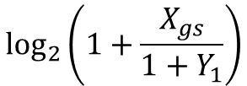



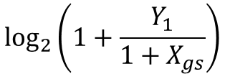

$$R_{1}^{HBD}$$
$$\log_{2}\left(1+Y_{1}\right)$$
$$𝒪_{JD}^{2}$$
$$A3$$
$$A4$$
(JD, II)
(JD)
$$\log_{2}\left(1+\frac{Y_{1}}{1+X_{gs}}\right)$$
$$𝒪_{JD}^{1}$$
$$A1$$
$$A2$$
(JD, II, SIC)
(JD, SIC)
$$R_{gs}^{HBD}$$
$$\log_{2}\left(1+\frac{X_{gs}}{1+Y_{1}}\right)$$
$$\log_{2}\left(1+X_{gs}\right)$$

